Slide 1


SQL PROJECT
FINANCE & SUPPLY CHAIN
ANALYTICS AT ATLIQ HARDWARE
PRESENľED BY
SAGAR PARKHE

Slide 2
PROJECT
OVERVIEW
OPTIMIZING ATLIQ HARDWARE’S OPERATIONS THROUGH SQL

Slide 3


ľABLE OF
CONľENľS
ABOUľ AľLIQ BUSINESS MODEL PROBLEM SľAľEMENľ REPORľS CONCLUSION

Slide 4

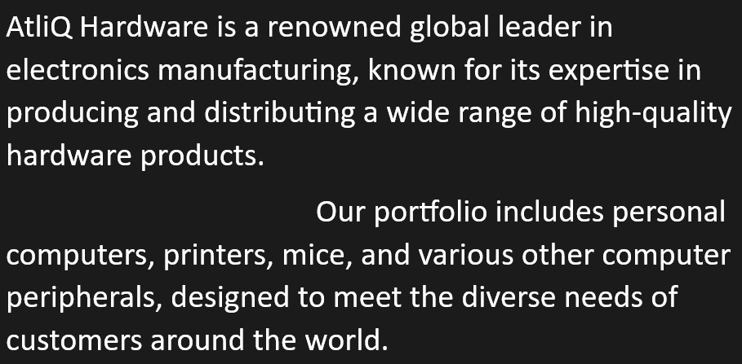
A T L I Q H A R D W A R E
&
B U S I N E S S M O D E L

Slide 5
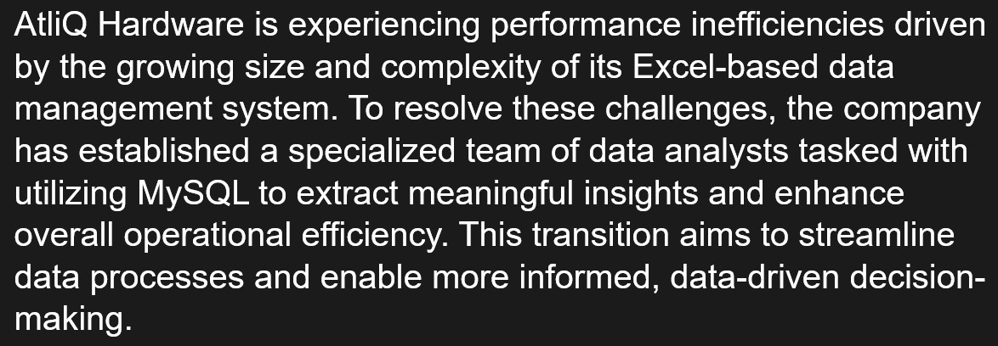
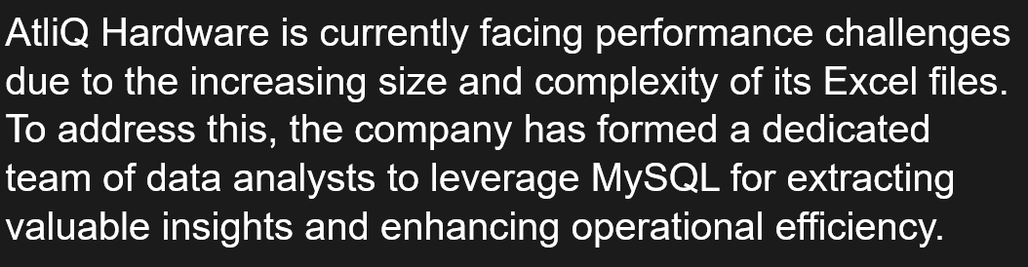
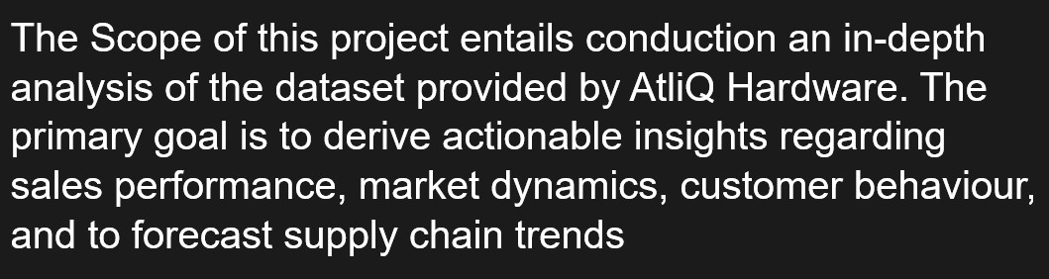
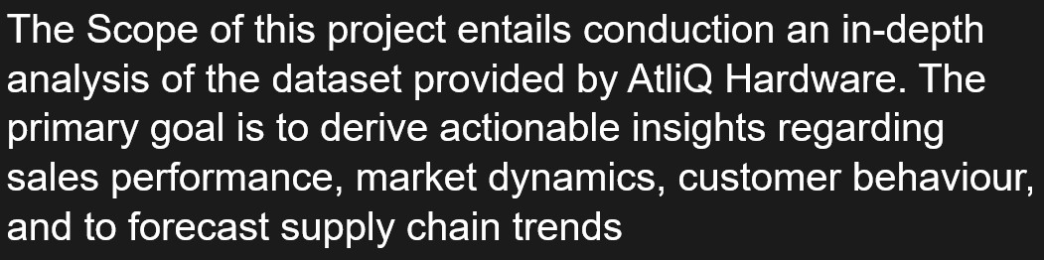
PROBLEM SľAľEMENľ
P R O B L E M
S T A T E M E N T
&
P R O B L E M
PROBLEM OVERVIEW
O V E R V I E W

Slide 6


DATA-SET
DIMENSION TABLES
FACT TABLES
FACT_FORECAST_MONTHLY
DIM_CUSTOMER
FACT_FREIGHT_COST
FACT_GROSS_PRICE
DIM_DATE
FACT_MANUFACTURING_COST
DIM_PRODUCT
FACT_POST_INVOICE_DEDUCTIONS
FACT_PRE_INVOICE_DEDUCTIONS
FACT_SALES_MONTHLY

Slide 7
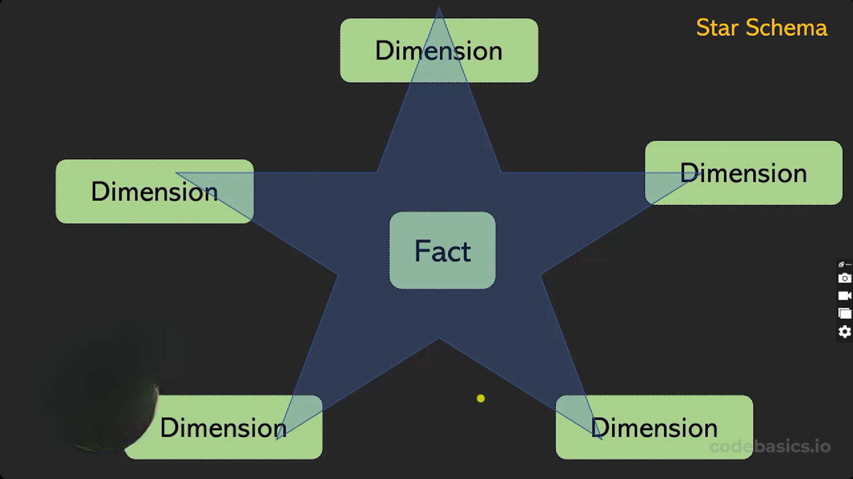


Slide 8
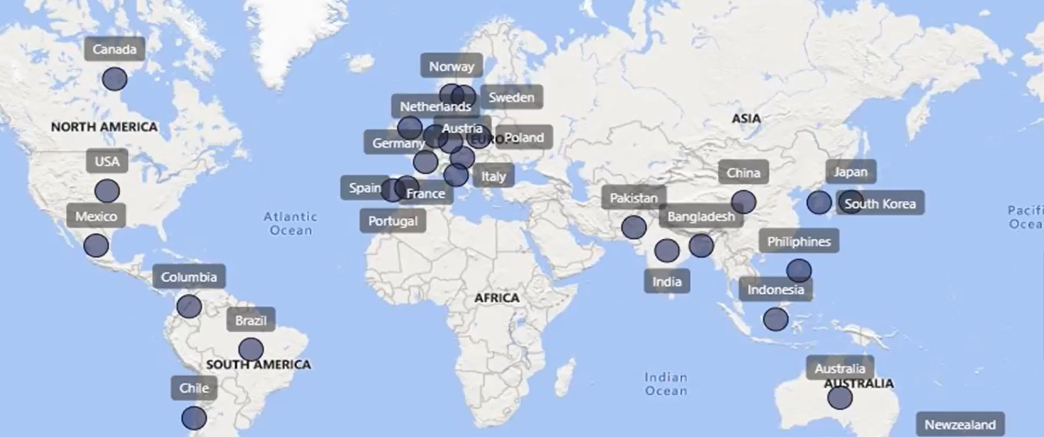
ATLIQ MARKET

Slide 9
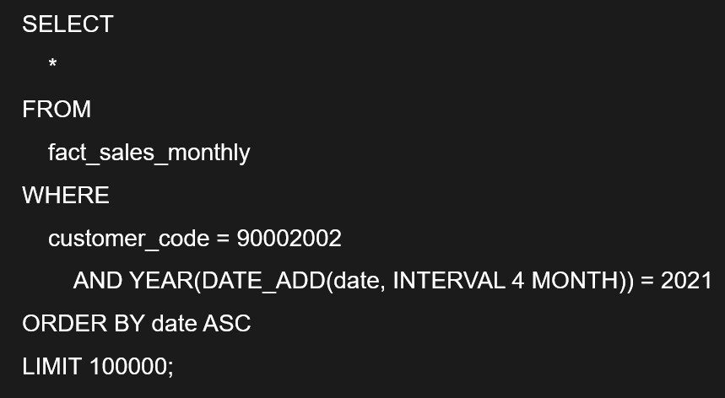
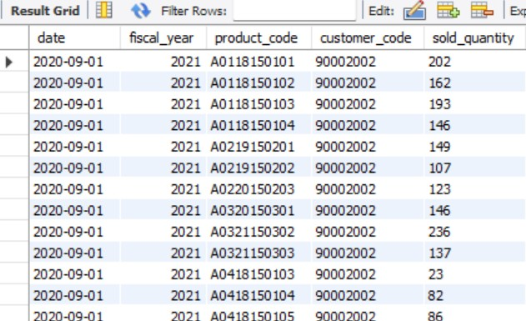
1. GET ALL THE SALES TRANSACTION DATA FROM FACT_SALES_MONTHLY TABLE FOR THAT CUSTOMER(CROMA: 90002002) IN THE FISCAL_YEAR 2021

Slide 10
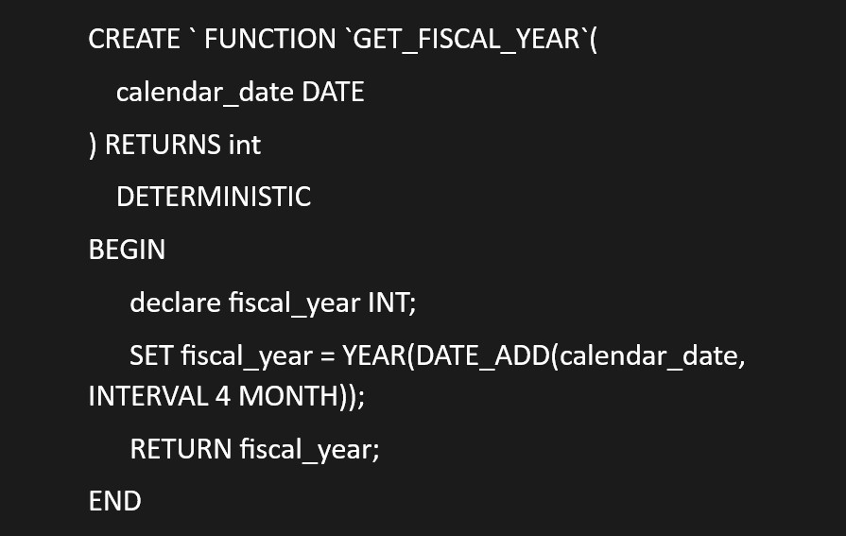
2. CREATE A FUNCTION 'GET_FISCAL_YEAR' TO GET FISCAL YEAR BY PASSING THE DATE

Slide 11
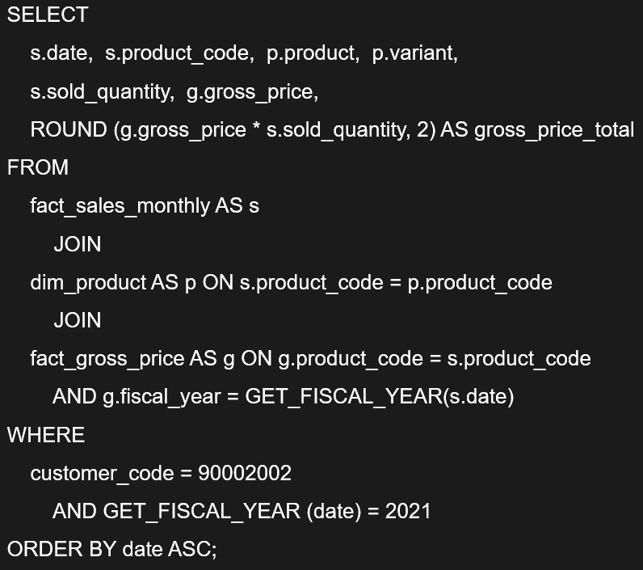
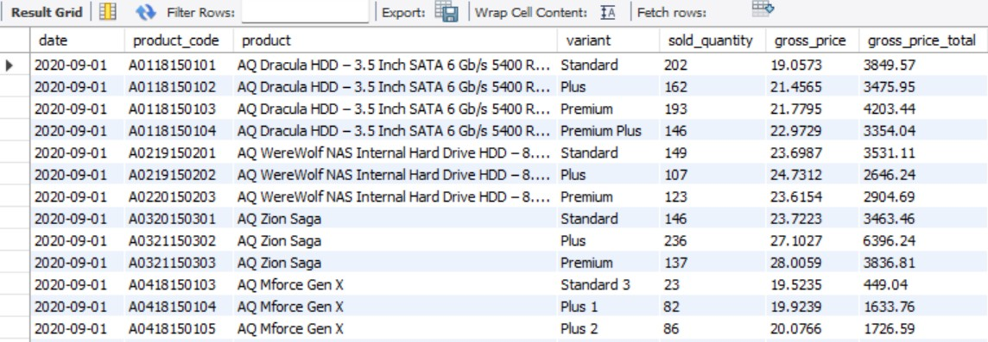
3. GENERATE A REPORT DETAILING THE INDIVIDUAL PRODUCT SALES FOR CROMA INDIA CUSTOMER THROUGHOUT THE FISCAL
YEAR 2021

Slide 12
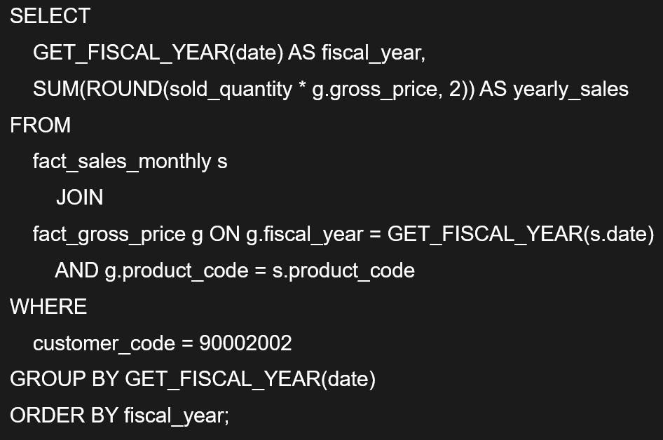
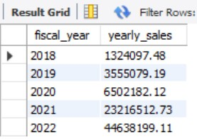
GENERATE A YEARLY REPORT FOR CROMA INDIA WHERE THERE ARE TWO COLUMNS:
FISCAL YEAR
TOTAL GROSS SALES AMOUNT IN THAT YEAR FROM CROMA

Slide 13
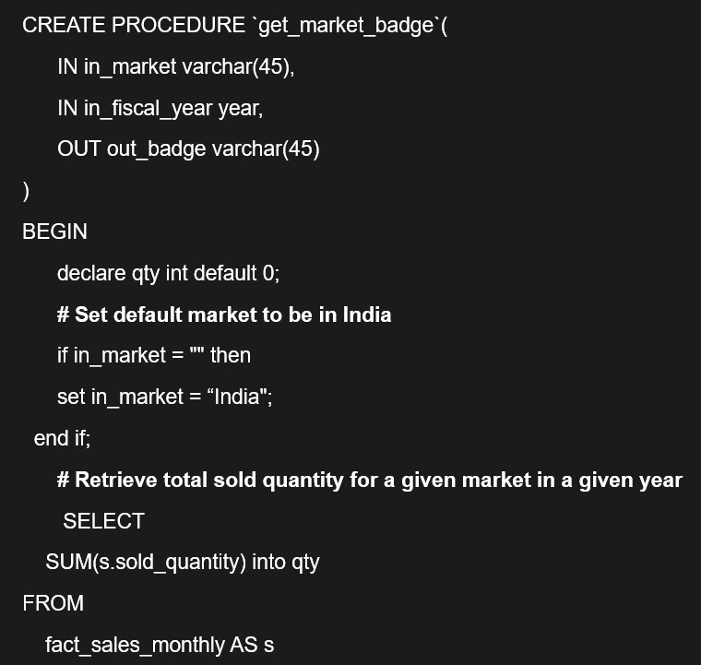
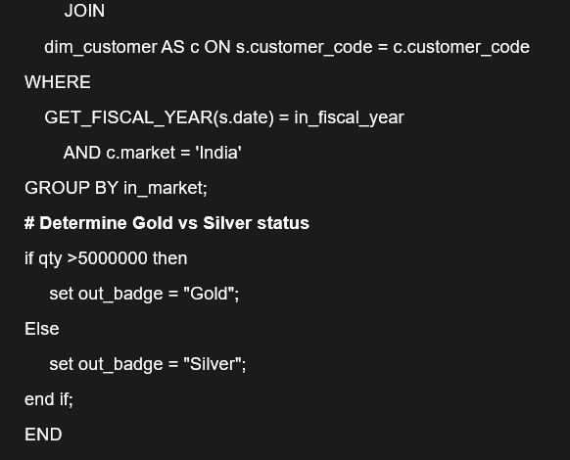
5. WRITE A STORED PROCEDURE THAT CAN RETRIEVE MARKET BADGE. I.E. IF TOTAL SOLD QUANTITY > 5 MILLION THAT MARKET IS
CONSIDERED "GOLD" ELSE "SILVER"

Slide 14
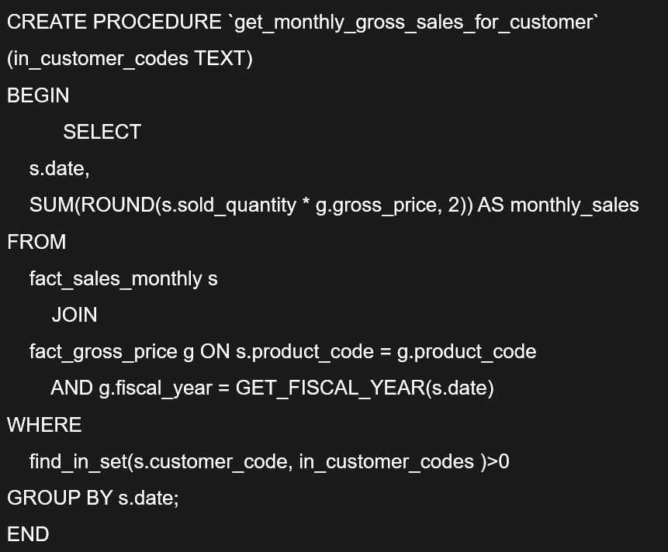
6.
GENERATE MONTHLY GROSS SALES REPORT FOR ANY CUSTOMER USING STORED PROCEDURE

Slide 15
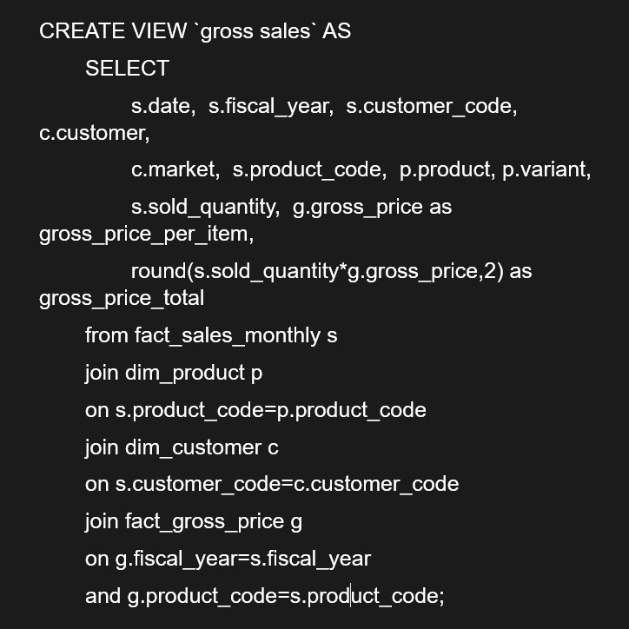
7. CREATE A VIEW FOR GROSS SALES. IT SHOULD
HAVE THE FOLLOWING COLUMNS:
-
DATE, FISCAL_YEAR, CUSTOMER_CODE, CUSTOMER, MARKET, PRODUCT_CODE, PRODUCT, VARIANT,
SOLD_QUANITY, GROSS_PRICE_PER_ITEM, GROSS_PRICE_TOTAL

Slide 16
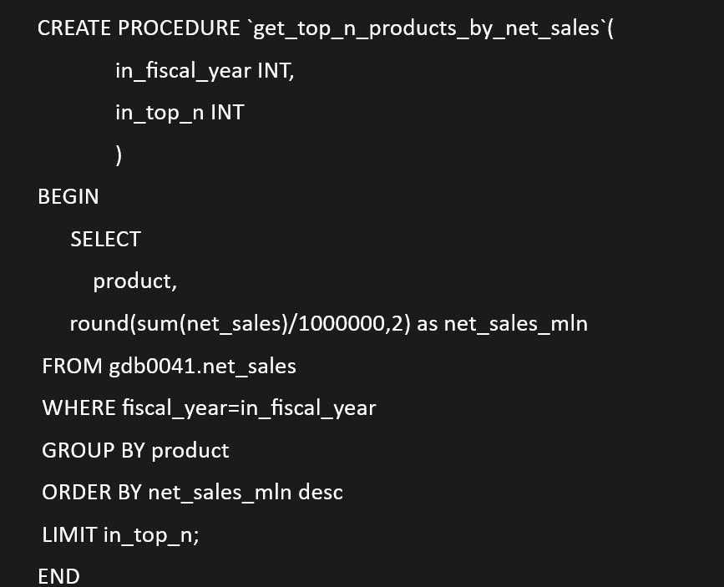
8. WRITE A STORED PROCEDURE TO GET THE TOP N PRODUCTS BY NET SALES FOR A
GIVEN YEAR.
USE PRODUCT NAME WITHOUT A VARIANT. INPUT OF STORED PROCEDURE IS FISCAL_YEAR AND TOP_N PARAMETER

Slide 17
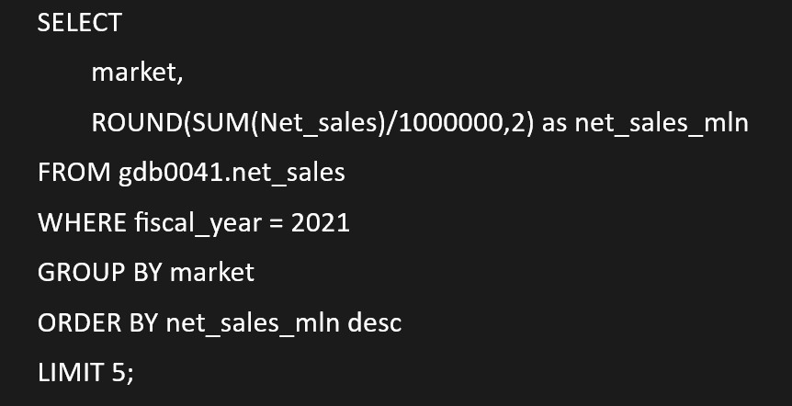
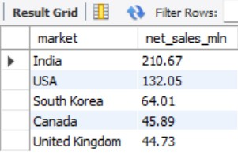
9. GENERATE A REPORT GETTING TOP 5 MARKETS BY NET SALES IN FISCAL YEAR 2021

Slide 18
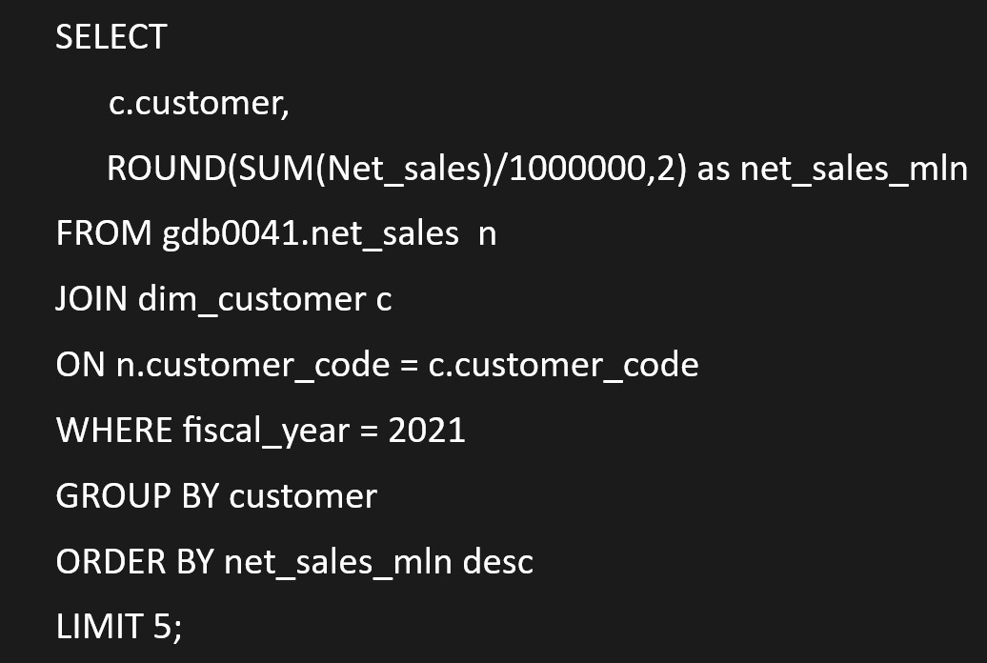
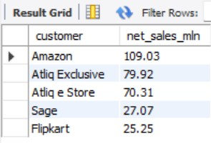
10. GENERATE A REPORT GETTING TOP 5 CUSTOMERS BY NET SALES IN FISCAL YEAR 2021

Slide 19
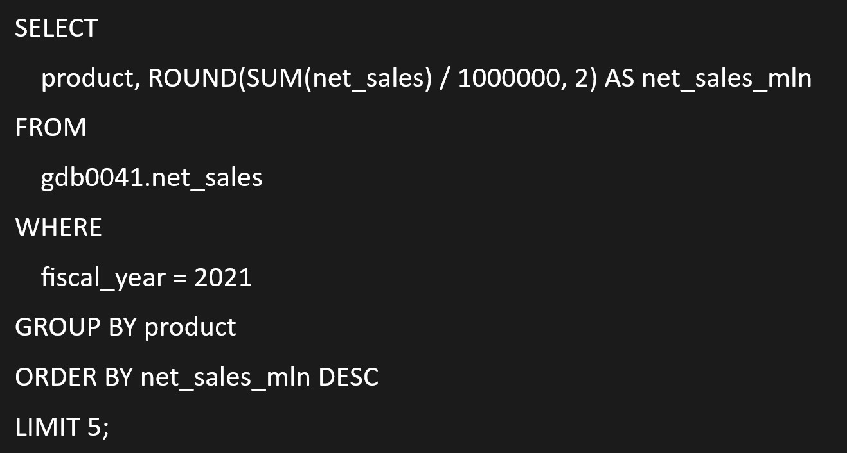
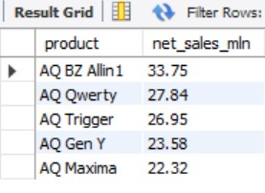
11. GENERATE A REPORT GETTING TOP 5 PRODUCTS BY NET SALES IN FISCAL YEAR 2021

Slide 20
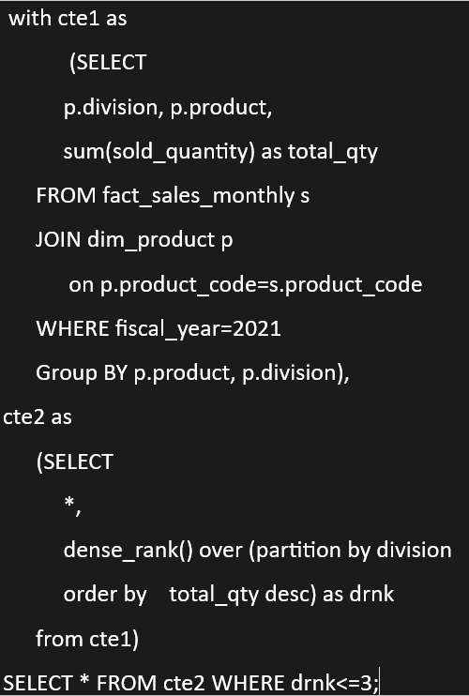
12.
FIND OUT TOP 3 PRODUCTS FROM EACH DIVISION BY TOTAL QUANTITY SOLD IN A GIVEN YEAR

Slide 21
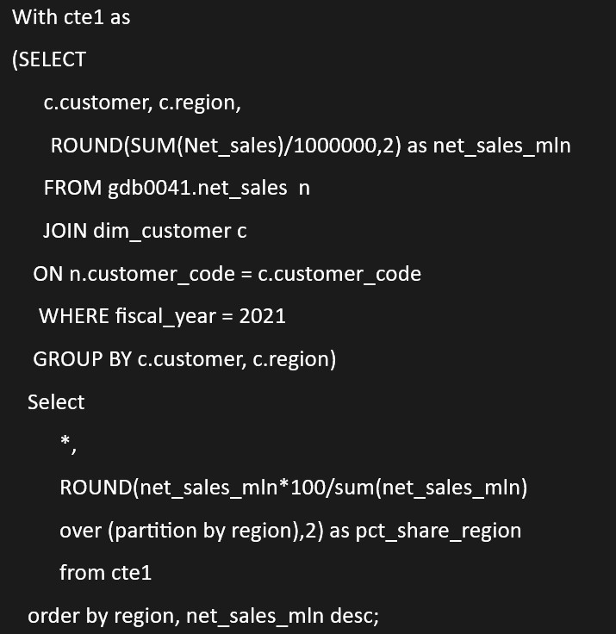
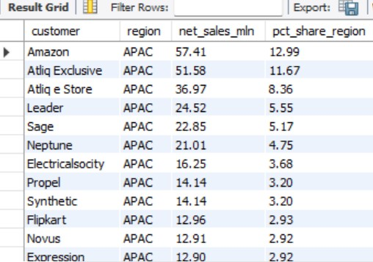
13. GENERATE A NET SALES % REPORT OF CUSTOMERS IN DIFFERENT REGIONS

Slide 22
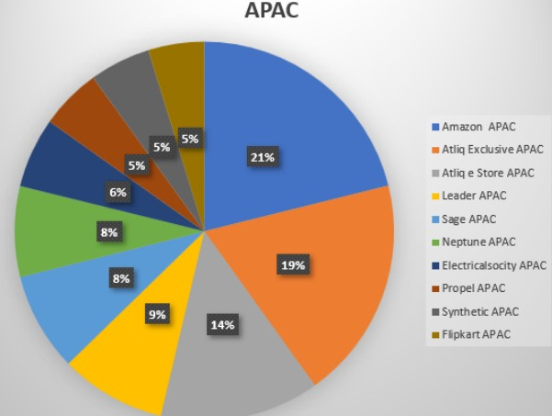
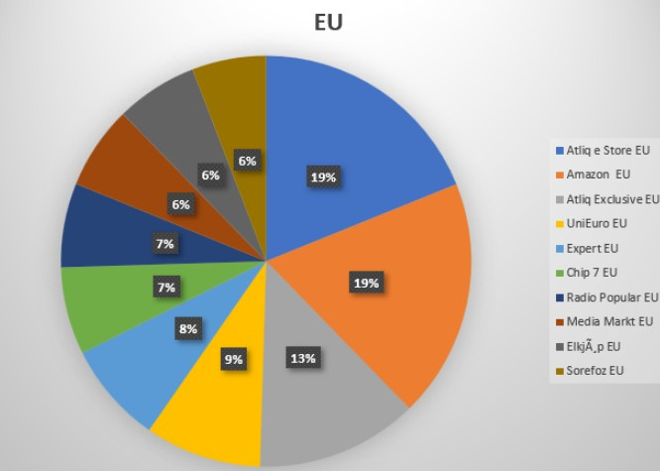
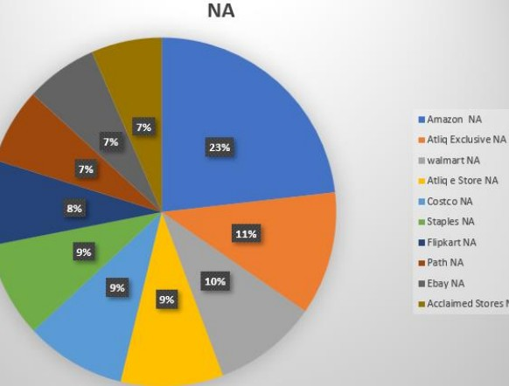
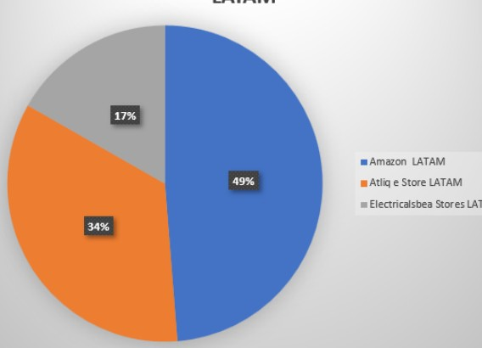
14.
MARKET SHARE % - TOP CUSTOMERS IN DIFFERENT REGIONS

Slide 23
CONCLUSION
ATLIQ HARDWARE ACHIEVED RECORD SALES IN 2022.
INDIA WAS THE LARGEST MARKET IN 2021 WITH SALES OF $210.67M AMAZON GENERATED THE HIGHEST NET SALES IN 2021 WITH $109.03M
THE AQ BZ ALL-IN-ONE WAS THE TOP-SELLING PRODUCT IN 2021 WITH THE SALES OF $33.75M
AMAZON CAPTURES THE TOP MARKET SHARE% IN APAX, LATAM & NA REGIONS.
ATLIQ ESTORE TOPPED THE CHART IN EU REGION.

Slide 24

THANK YOU
FOR YOUR
ATTENTION

